Slide 1
Smart Educational Resources
Adopting mobile devices and adapting strategies
Organized by ACJI Training in Faro, Portugal from 8th to 12th of july 2019

Slide 2
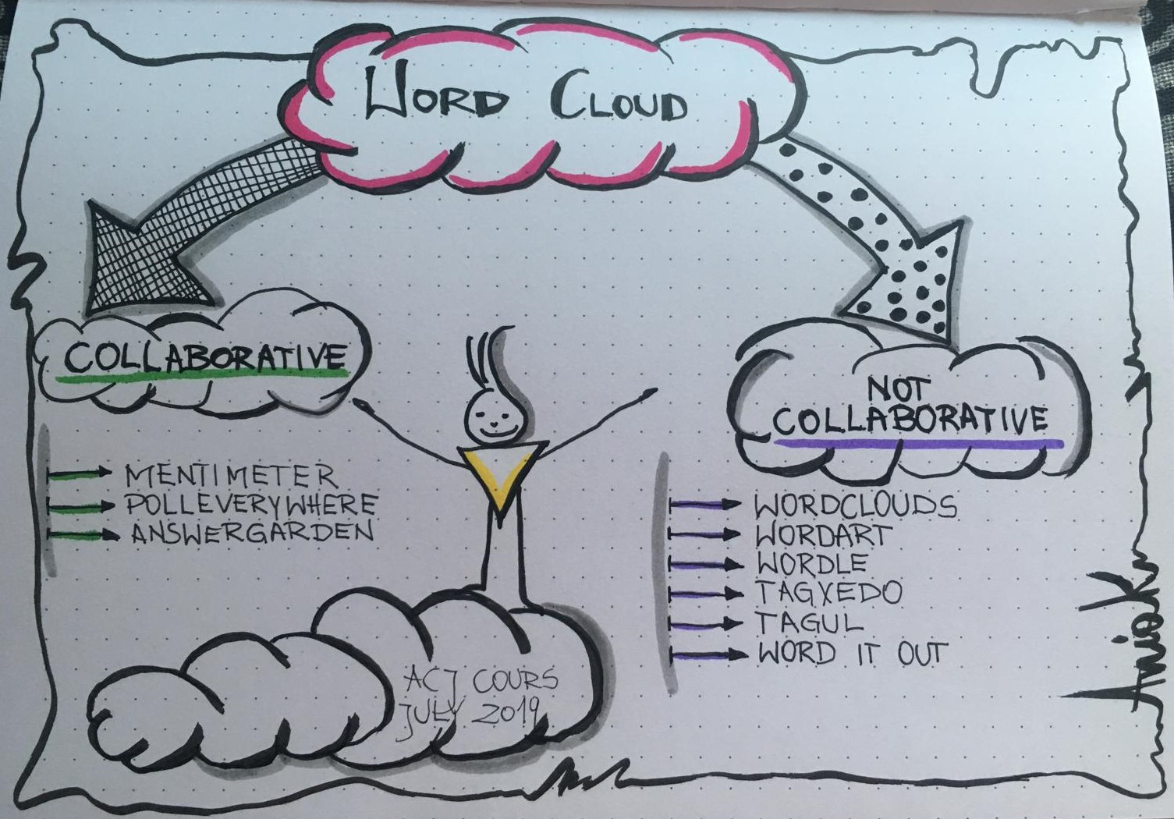
Application types for teaching and learning

Slide 3
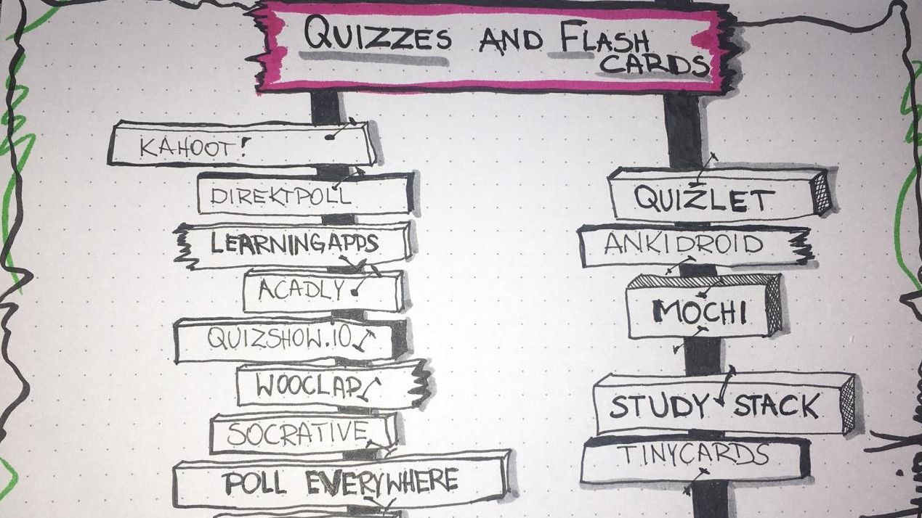

Slide 4
Digital Intruduction - benefits
Possibilities to introduce myself with an app:
Emoji
Bitme
Avatar
Padlet:
Title_name of my college
Details about him/her
Settings:
Require Aproval - cenzura
Useful videos, researches about digital challenges:
Internet addiction and digital natives challanges – video
Usage time - how long do You use your smartphone
Raisingdigitalnatives.com - TEDX video
ZEN Screen - block the screen after 10 times looking for e.g.

Slide 5
Applications for digital Learning
Collaborative applications
FLIPPED CLASSROOM
Padlet
Trello
Popplet
iBrainstorm
RealtimeBoard
Stromboard
IN FLIP model
GROUP
INDIVIDUAL SPACE

Slide 6
Lesson structuring resources
Teachers to teachers - website for sharing knowledge,
Blendspace - You can sreate lessons by draging resources on a structured
Tes.com
Nearpod - very similar but with many features
KhanAcademy - already strustured video lessons and activities, several subjects, different languages
Learning apps - different activities, that can be arranged to build lessons
Deck Toys - sets of contents and activities organized in path with gaming environment - different levels with different activities; pupils can chose between the activitise.
APP for any subject: gap fill generator TARSIA
Bamboozle.com - games in teams

Slide 7
Apps for Geography
Google Earth
Geo challenge
Planet Geo
World citizen
APPS for Physics
Physics toolbox sensor suit
Acelerometer
Chemistry and Physics simulations
Physic virtual lab
Sonic tools
www.physics4kids.com
Apps for Chemistry
Periodic tables - Periodic droid
Periodic table 2019
Compete Chemistry App
Chamistry
APPS for P.E.
Team shake - random or not random selection of group members
Swortkit Kids - Lots of different activities, demonstrációval együtt
Polar GoFit - working only with IOS (IPHONE)
Interval Timer
Sweat Deck
Fitnessmeter (IOS)

Slide 8
Application to improve cognitive skills
APPLICATIONS for MATH
APPS for coding
Geogebra -
PhotoMath - lefényképezed a táblán lévő egyenletet, ez felismeri (Optical Caracter Recognition OCR)
És több megoldást kínál.
Symbol lab - angol, német, kínai, arab nyelven elérhető
Code.org
Scratch
MIT App Inventor
Caodecamedy
freeCodeCamp
W3Schools
Code with Google

Slide 9
APPS for languages
Duolingo - autonomous learning
Lyricstraining (learn with music) - Kategóriánként is válogathatsz, a zene alatt kell begépelni a hiányzó szavakat. Minél magasabb a fokozat, annál több szó hiányzik. Te is kreálhatsz saját feladatot. Testre szabhatod pl. hogy csak a föneveket vegye ki, vgy csak az igéket.
Google translator / DeepL - sokkal job, mint a googletranslator
Flowlingo
SymboTalk - szimbólumokkkalsegíti a kommunikációt. Special education
FuneasyLearn
Readtheory.org (very good, BUT requires previous configuration of students and teachers

Slide 10
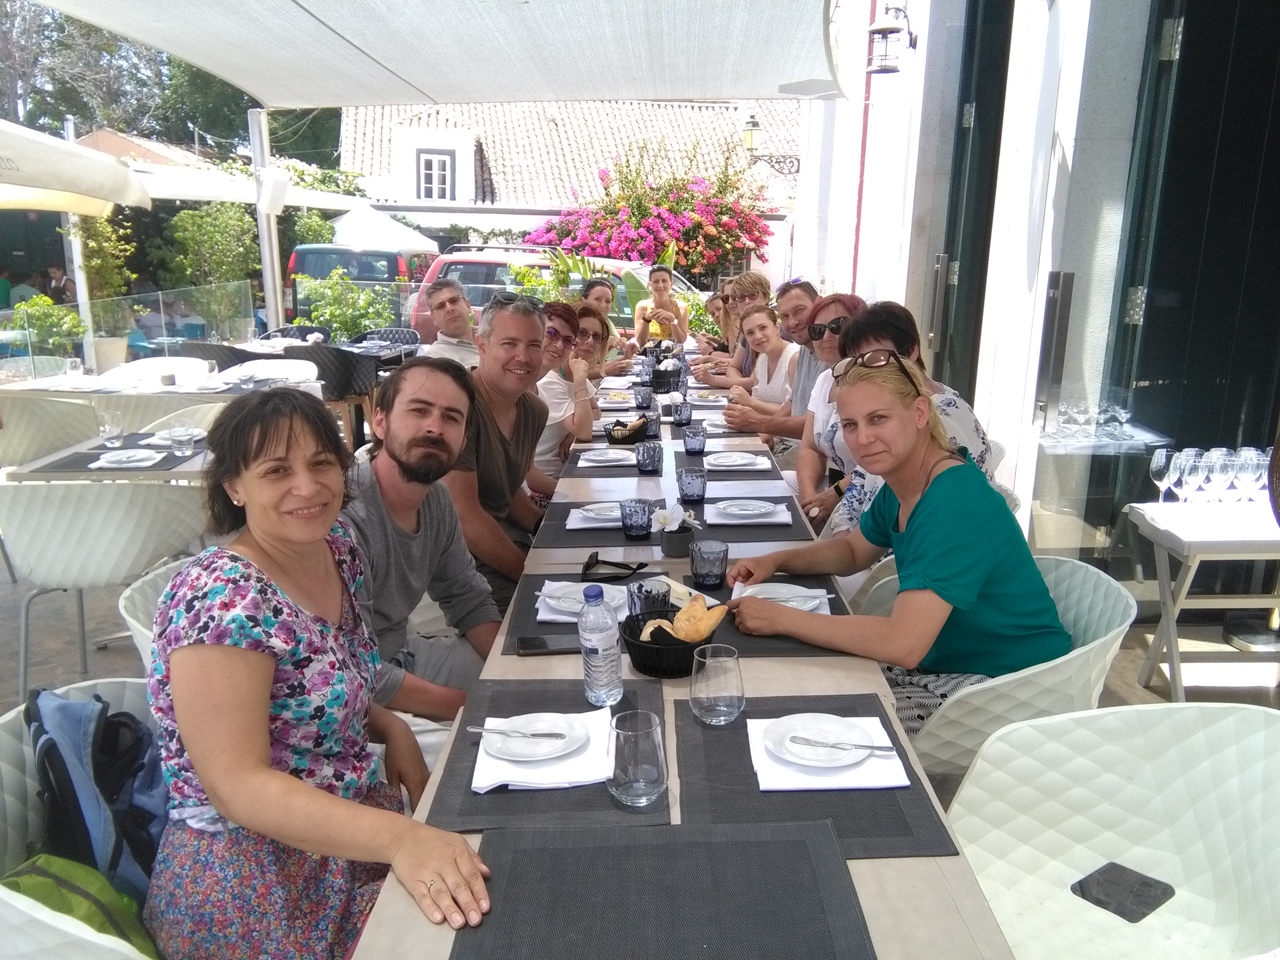
Thank You for this opportunity
I will never forget what I’ve learnt from ACJI Training

